Slide 1
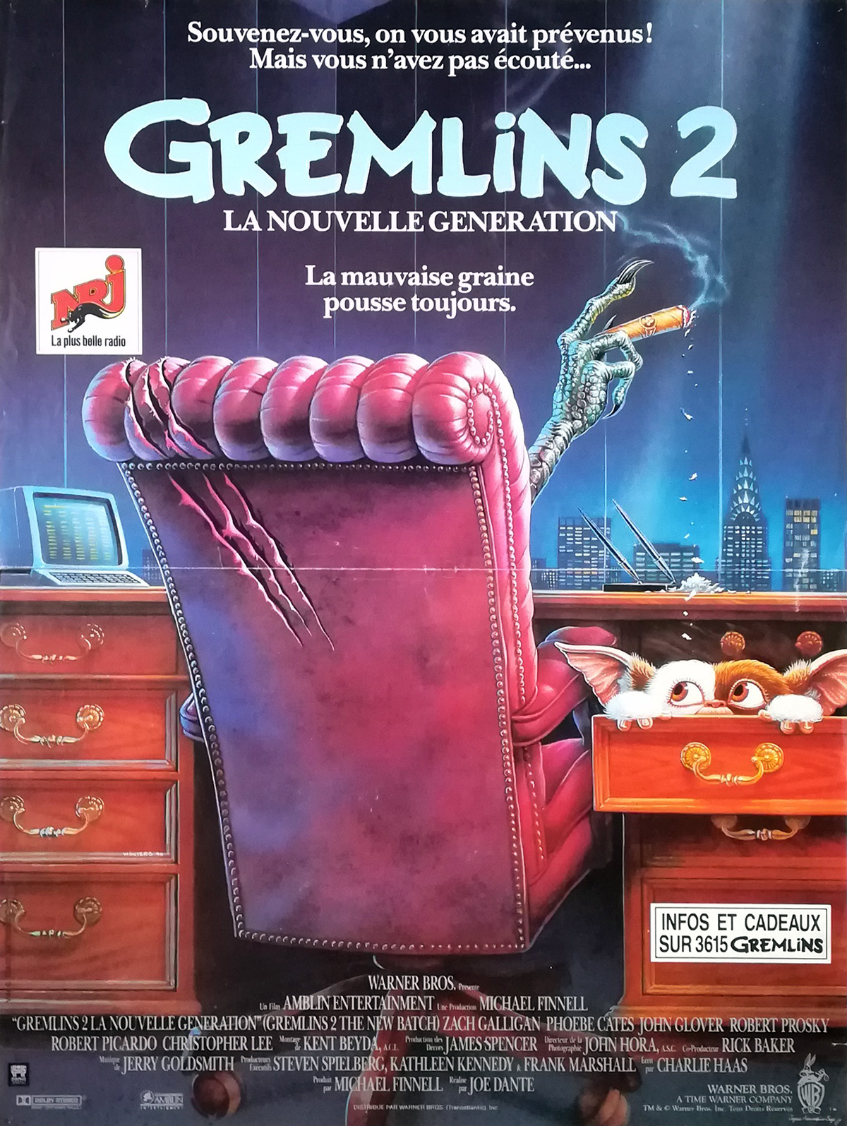
Gremlins 2 The New Batch
Annaëlle Winand
Montreal Monstrum Society
Championing the Horror Sequel Course
Fall, 2020

Slide 2
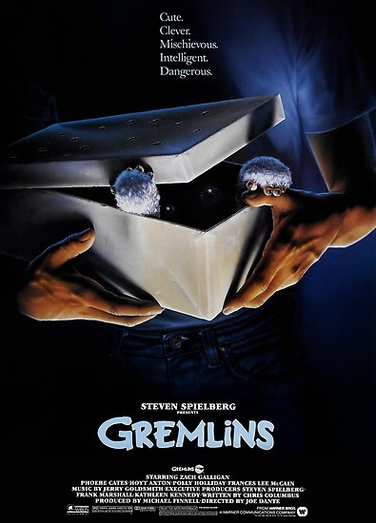
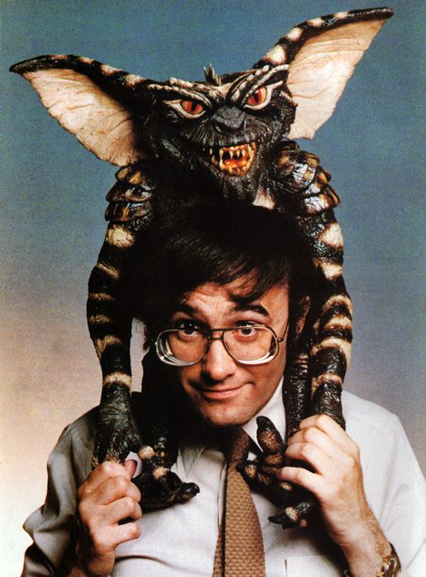
Gremlins (1984)

Slide 3
The New Batch (1990)
"You didn’t listen"

Slide 4
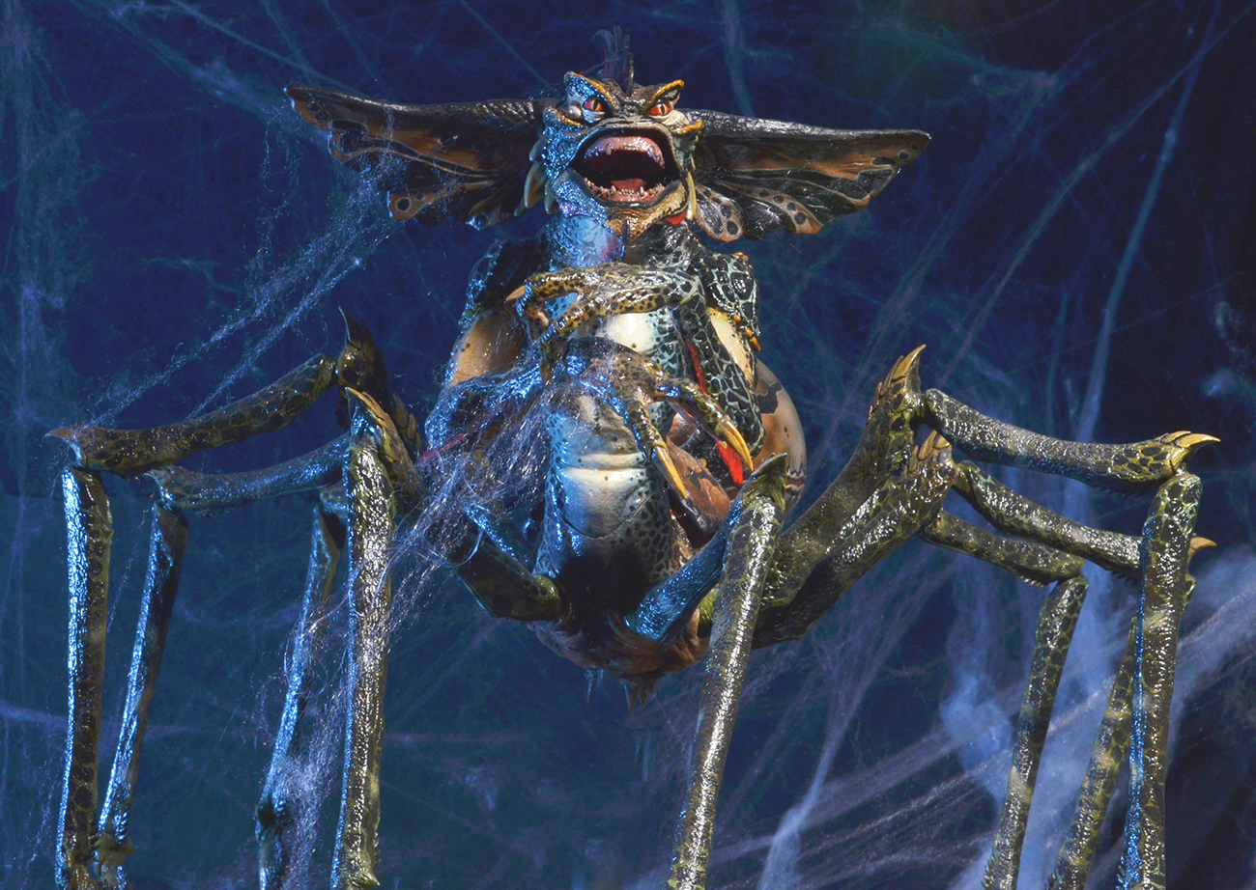
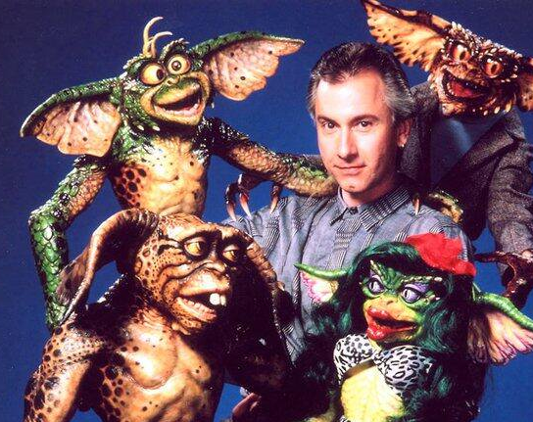
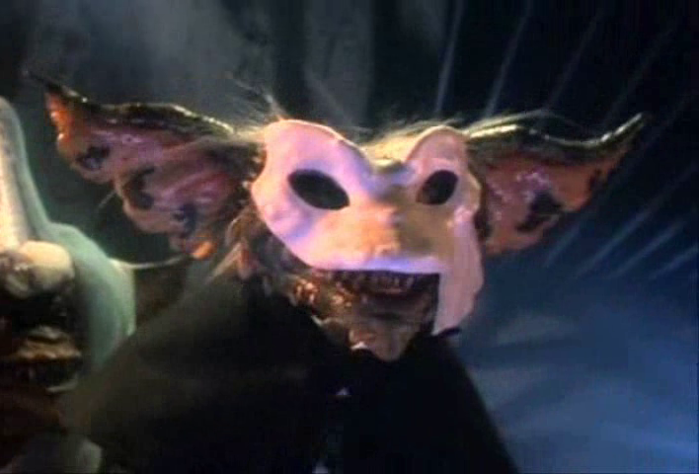
The New Batch (1990)
« it’s a pretty crazy, manic movie »
Joe Dante

Slide 5
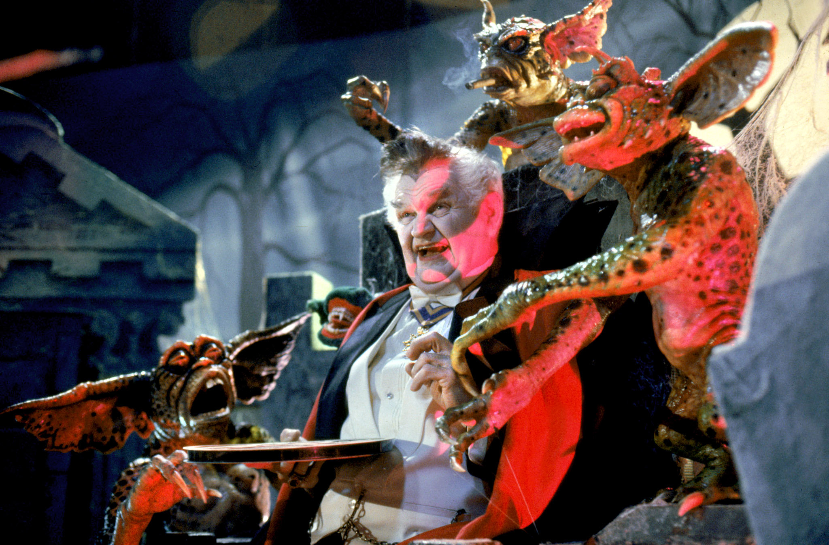
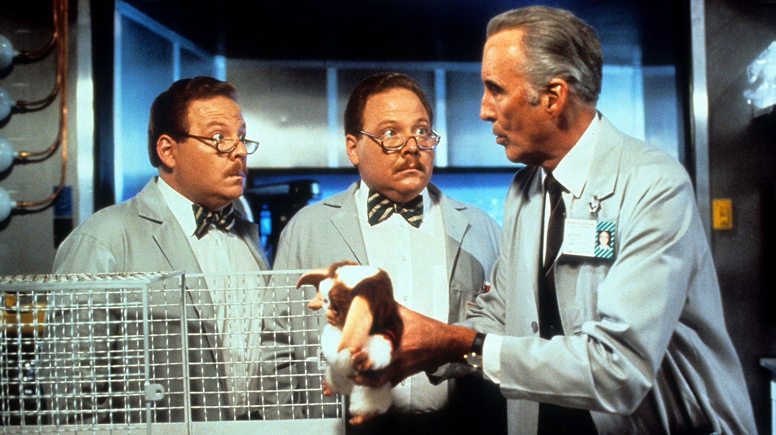
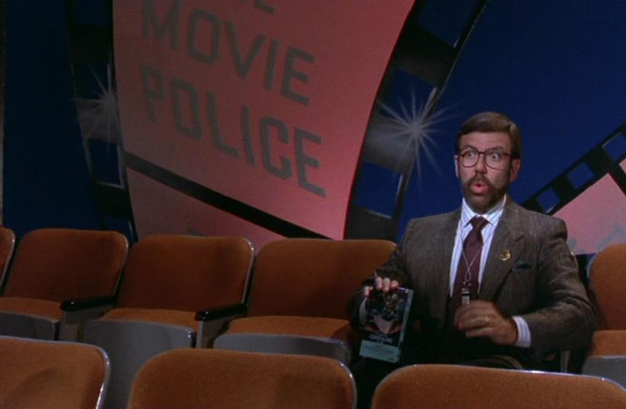
The New Batch (1990)
« Granted a rare degree of creative freedom, Mr. Dante seems to have set out to make the sequel to end all sequels. And if he didn’t quite achieve that noble goal, he did manage to create one of the most ferociously anarchic films ever made, a riot of topical gags, pop-culture references, political allusions and formal inventiveness that remains outrageously entertaining in its new Blu-ray incarnation »

Slide 6
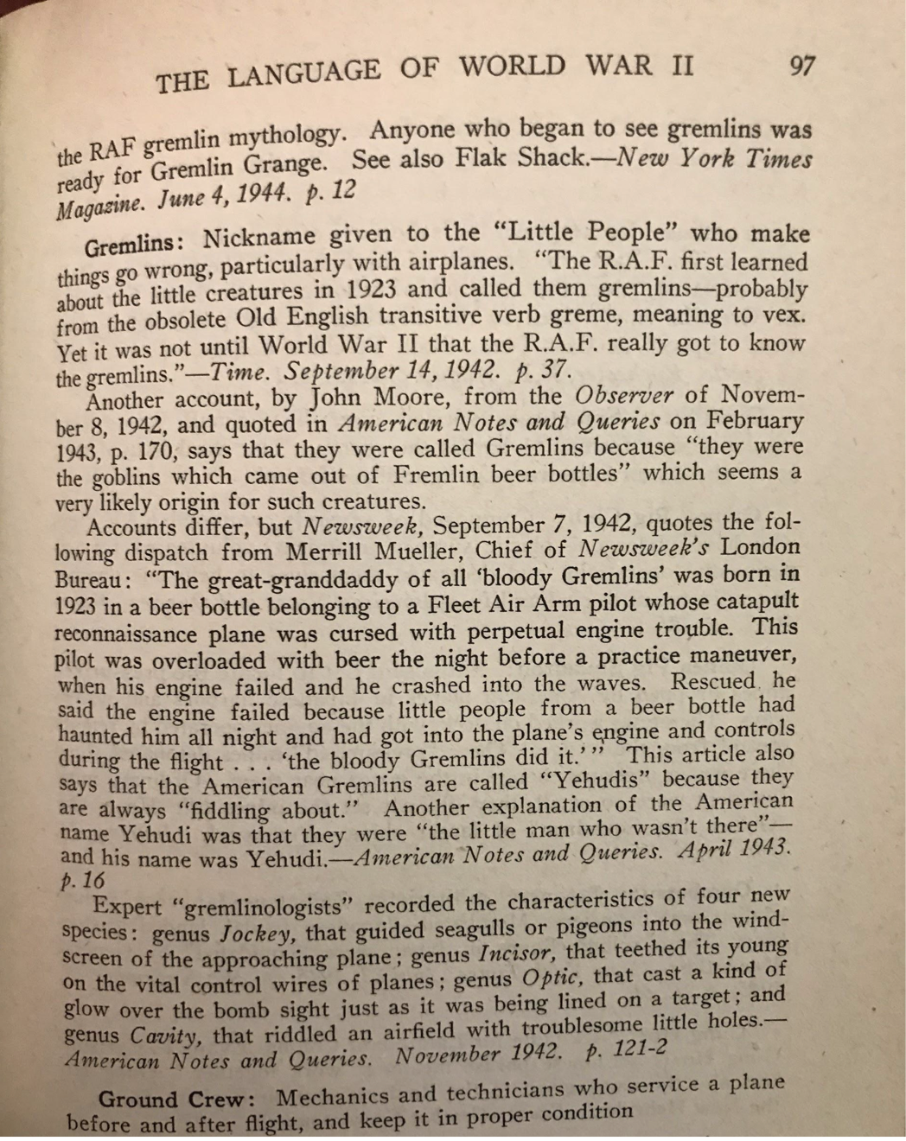
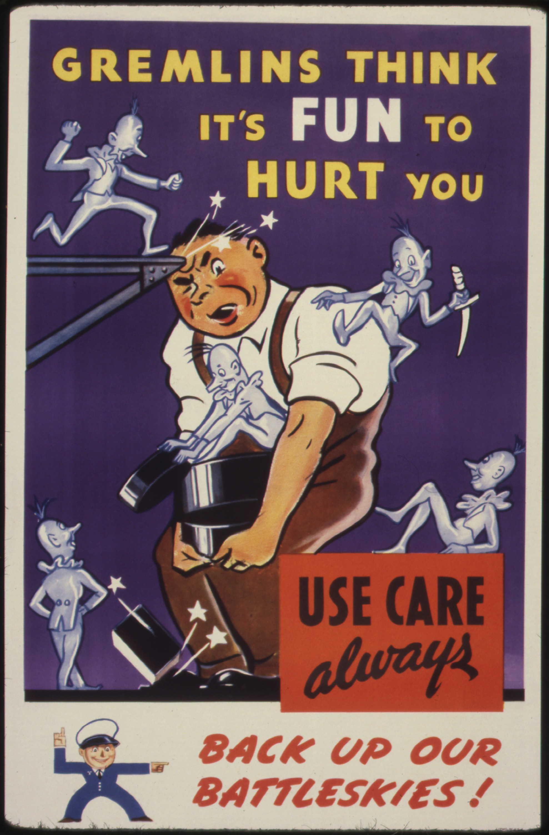
GLITCHES, TECHNOLOGY and GREMLINS

Slide 7
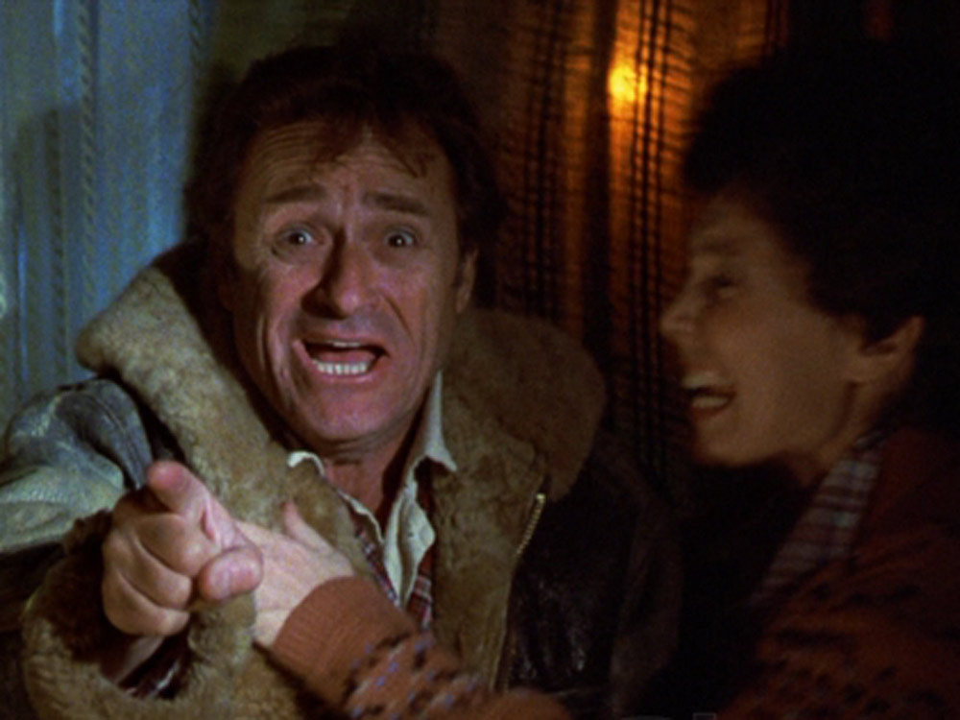
GLITCHES, TECHNOLOGY and GREMLINS

Slide 8
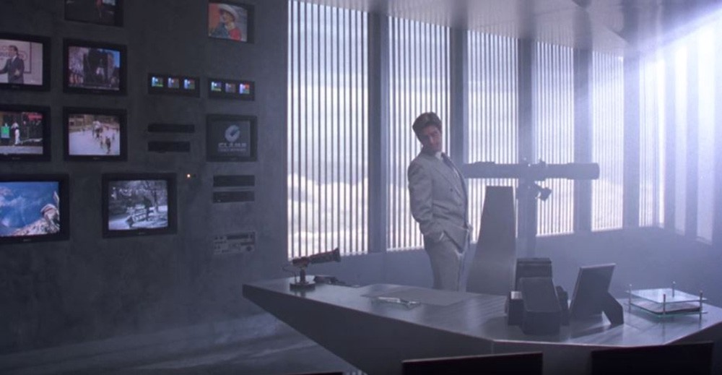
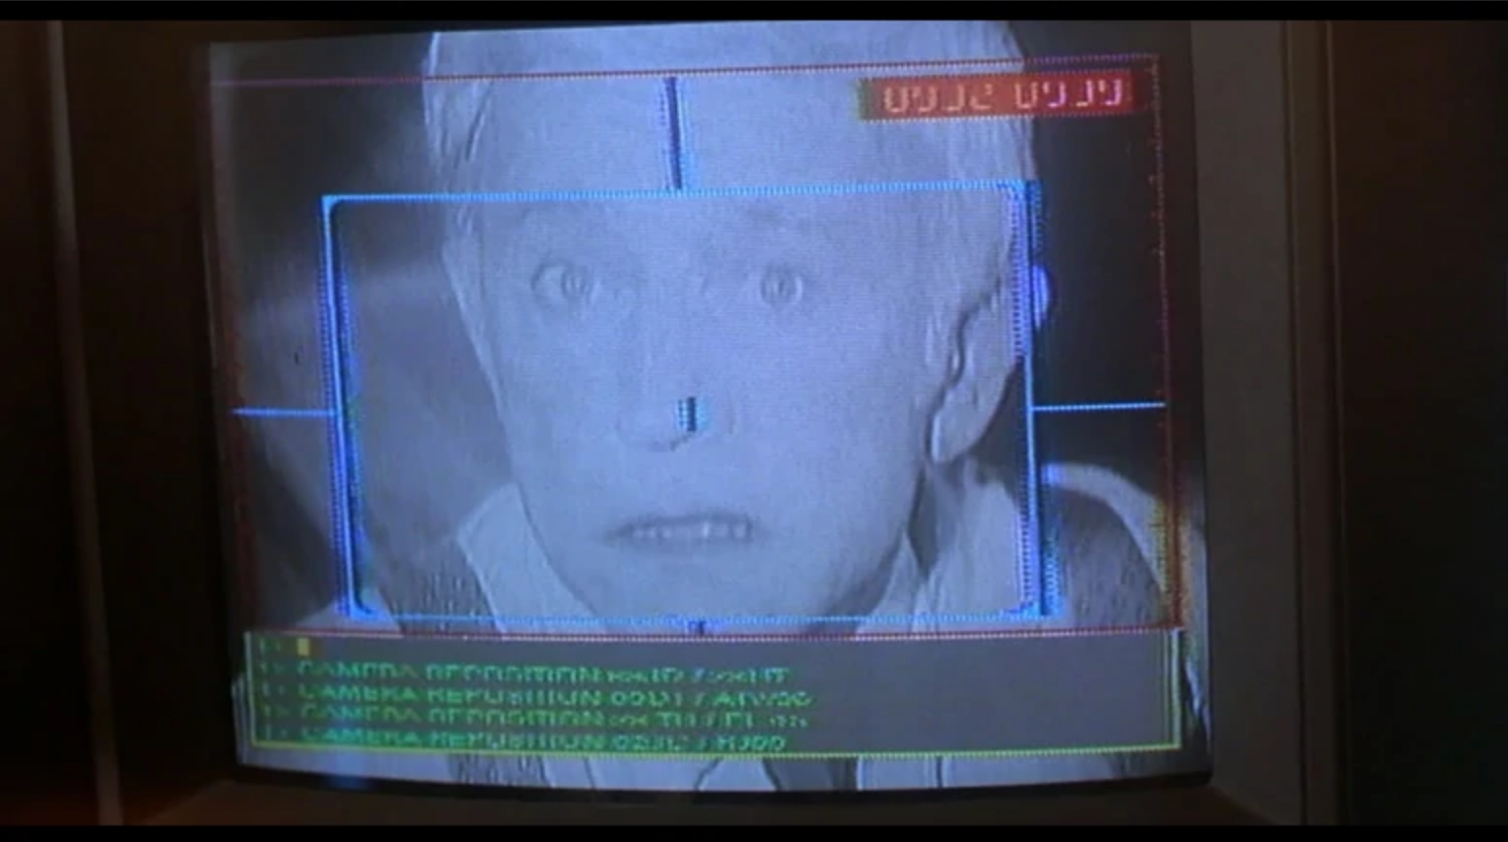
GLITCHES, TECHNOLOGY and GREMLINS

Slide 9
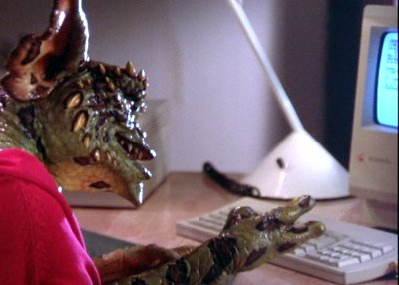
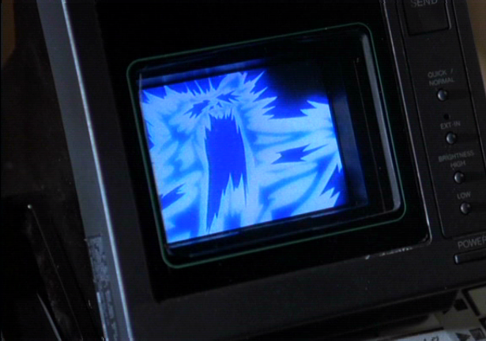
GLITCHES, TECHNOLOGY and GREMLINS

Slide 10
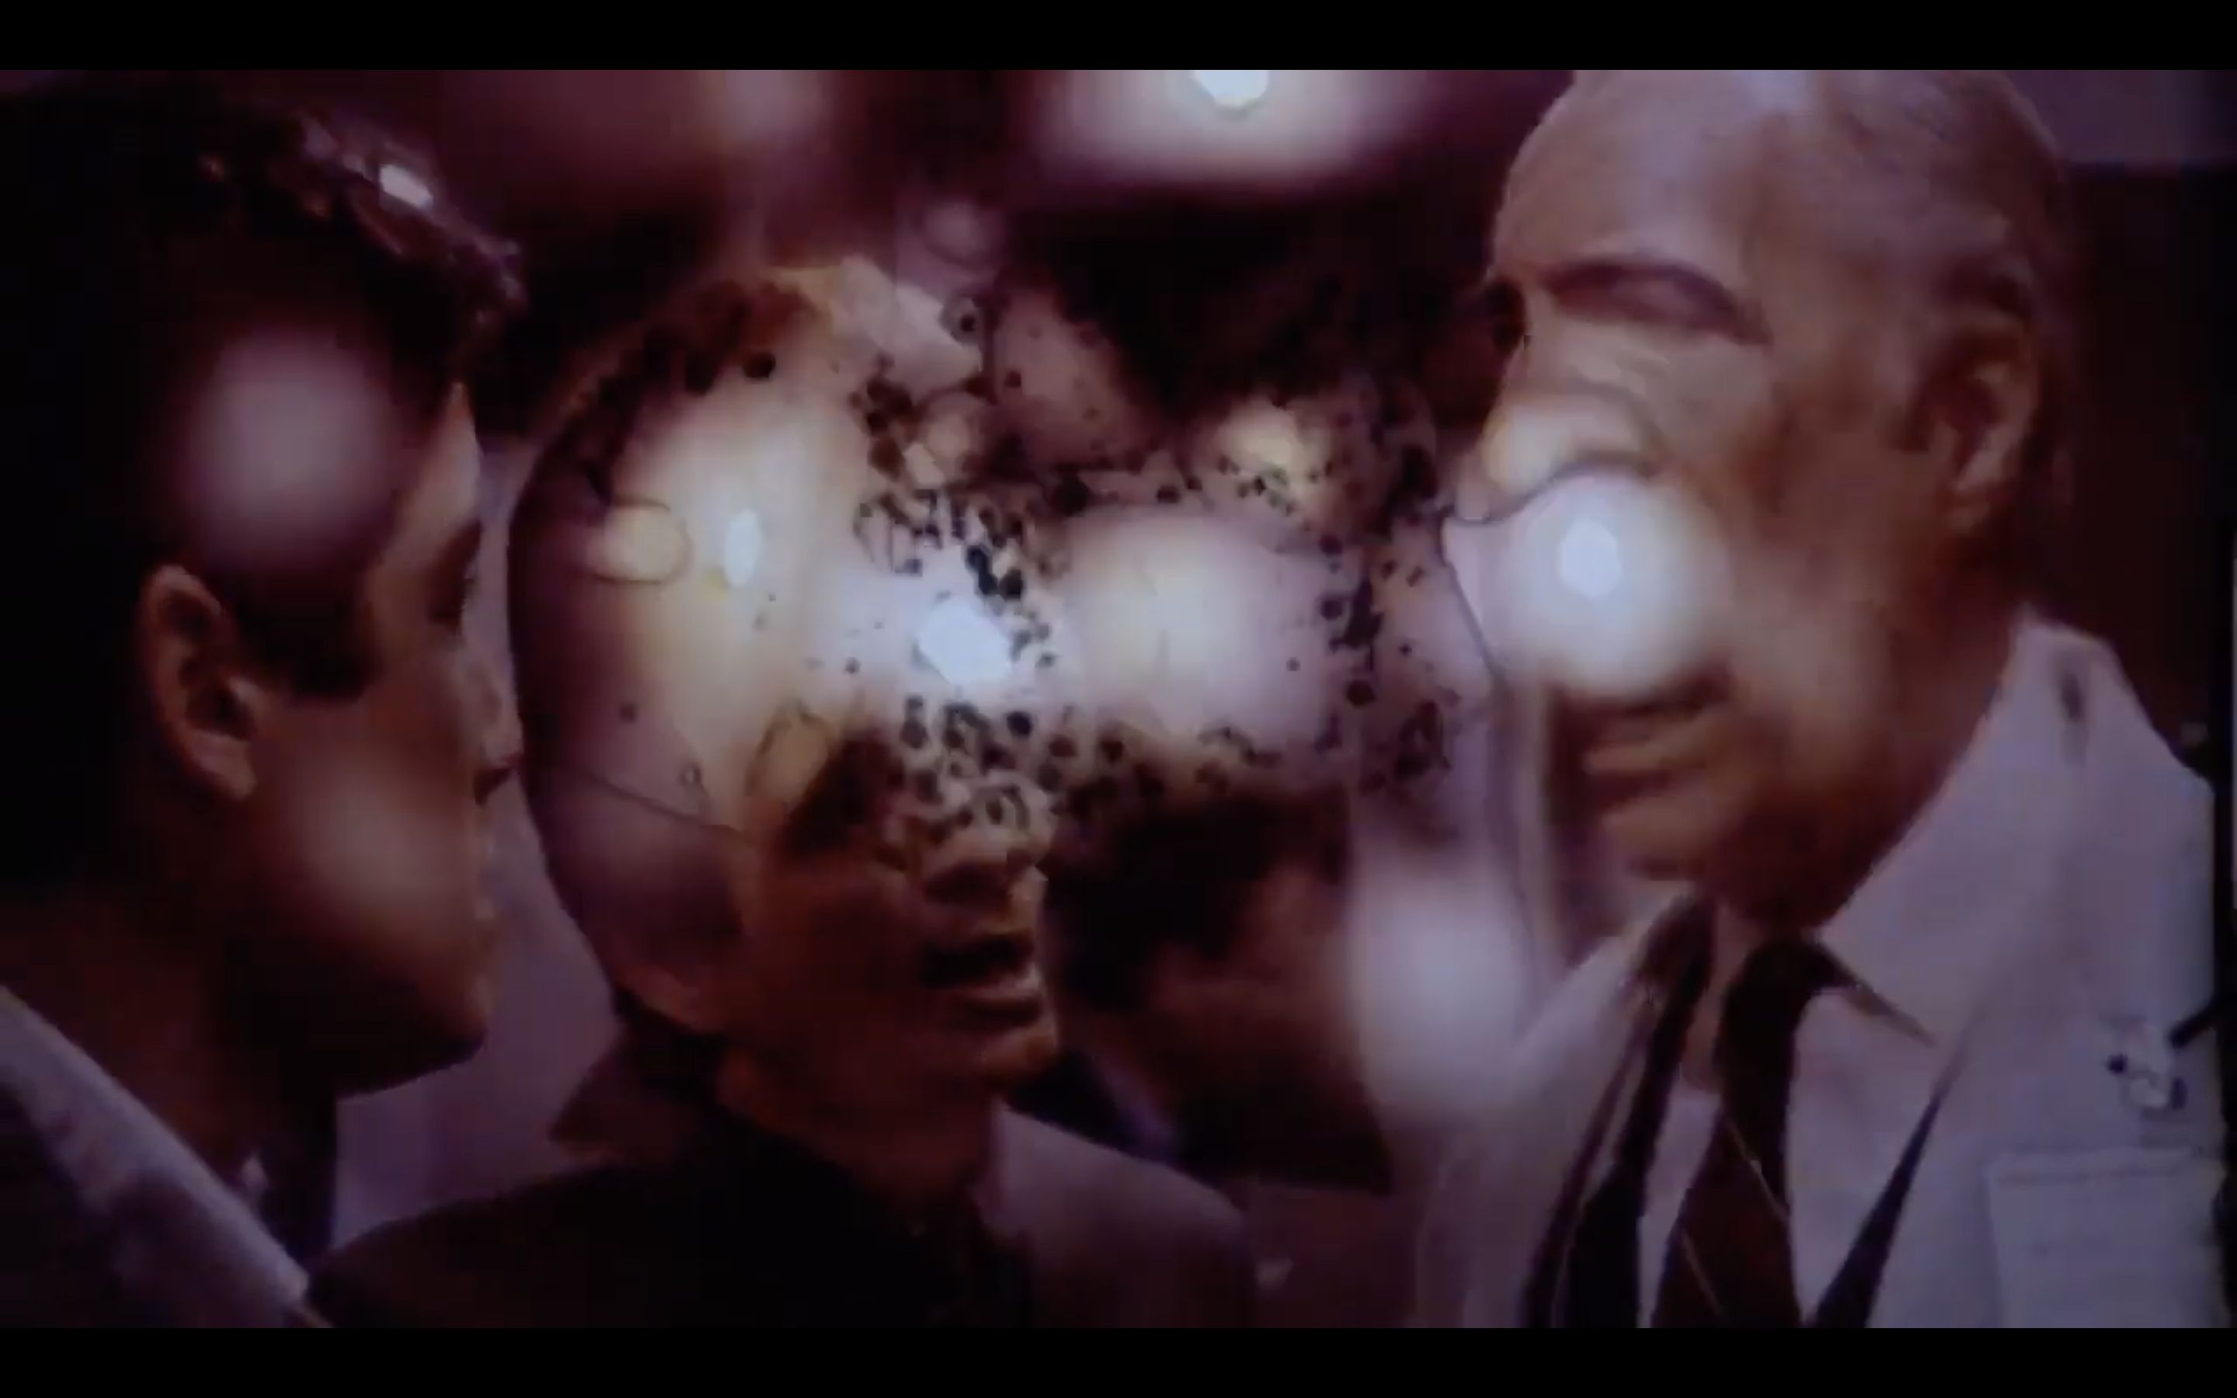
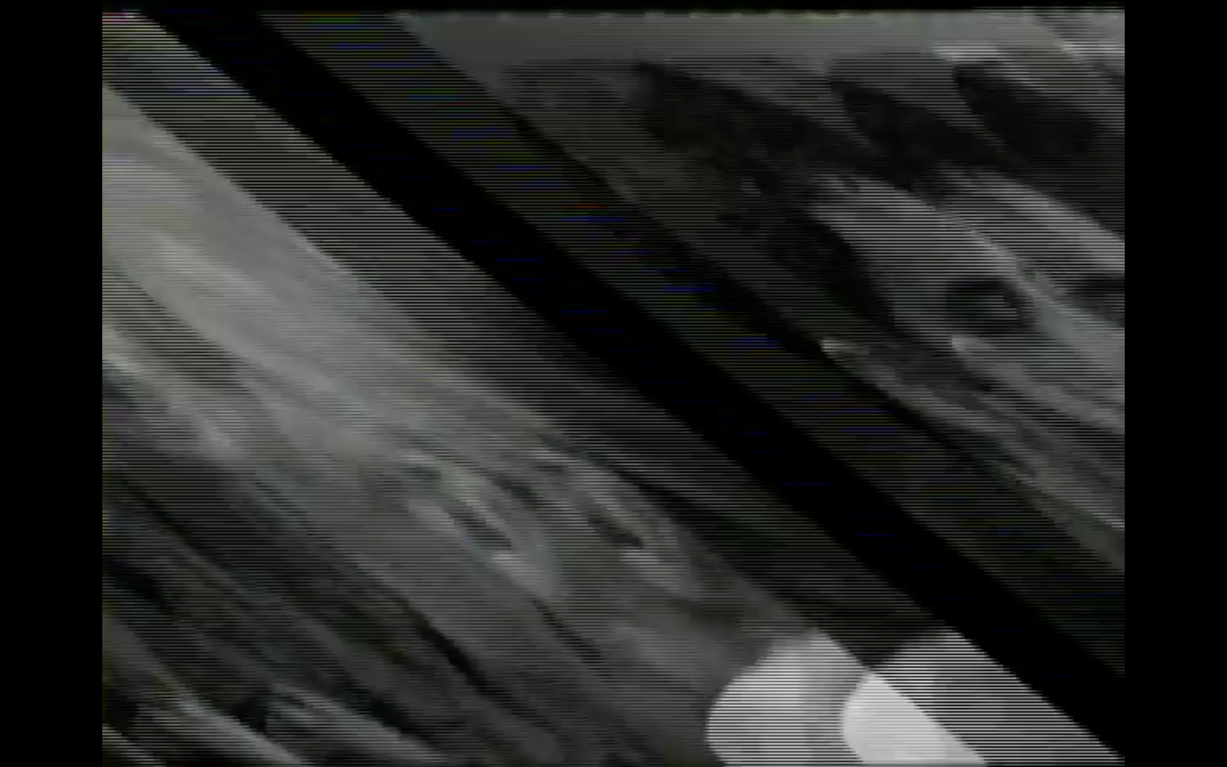
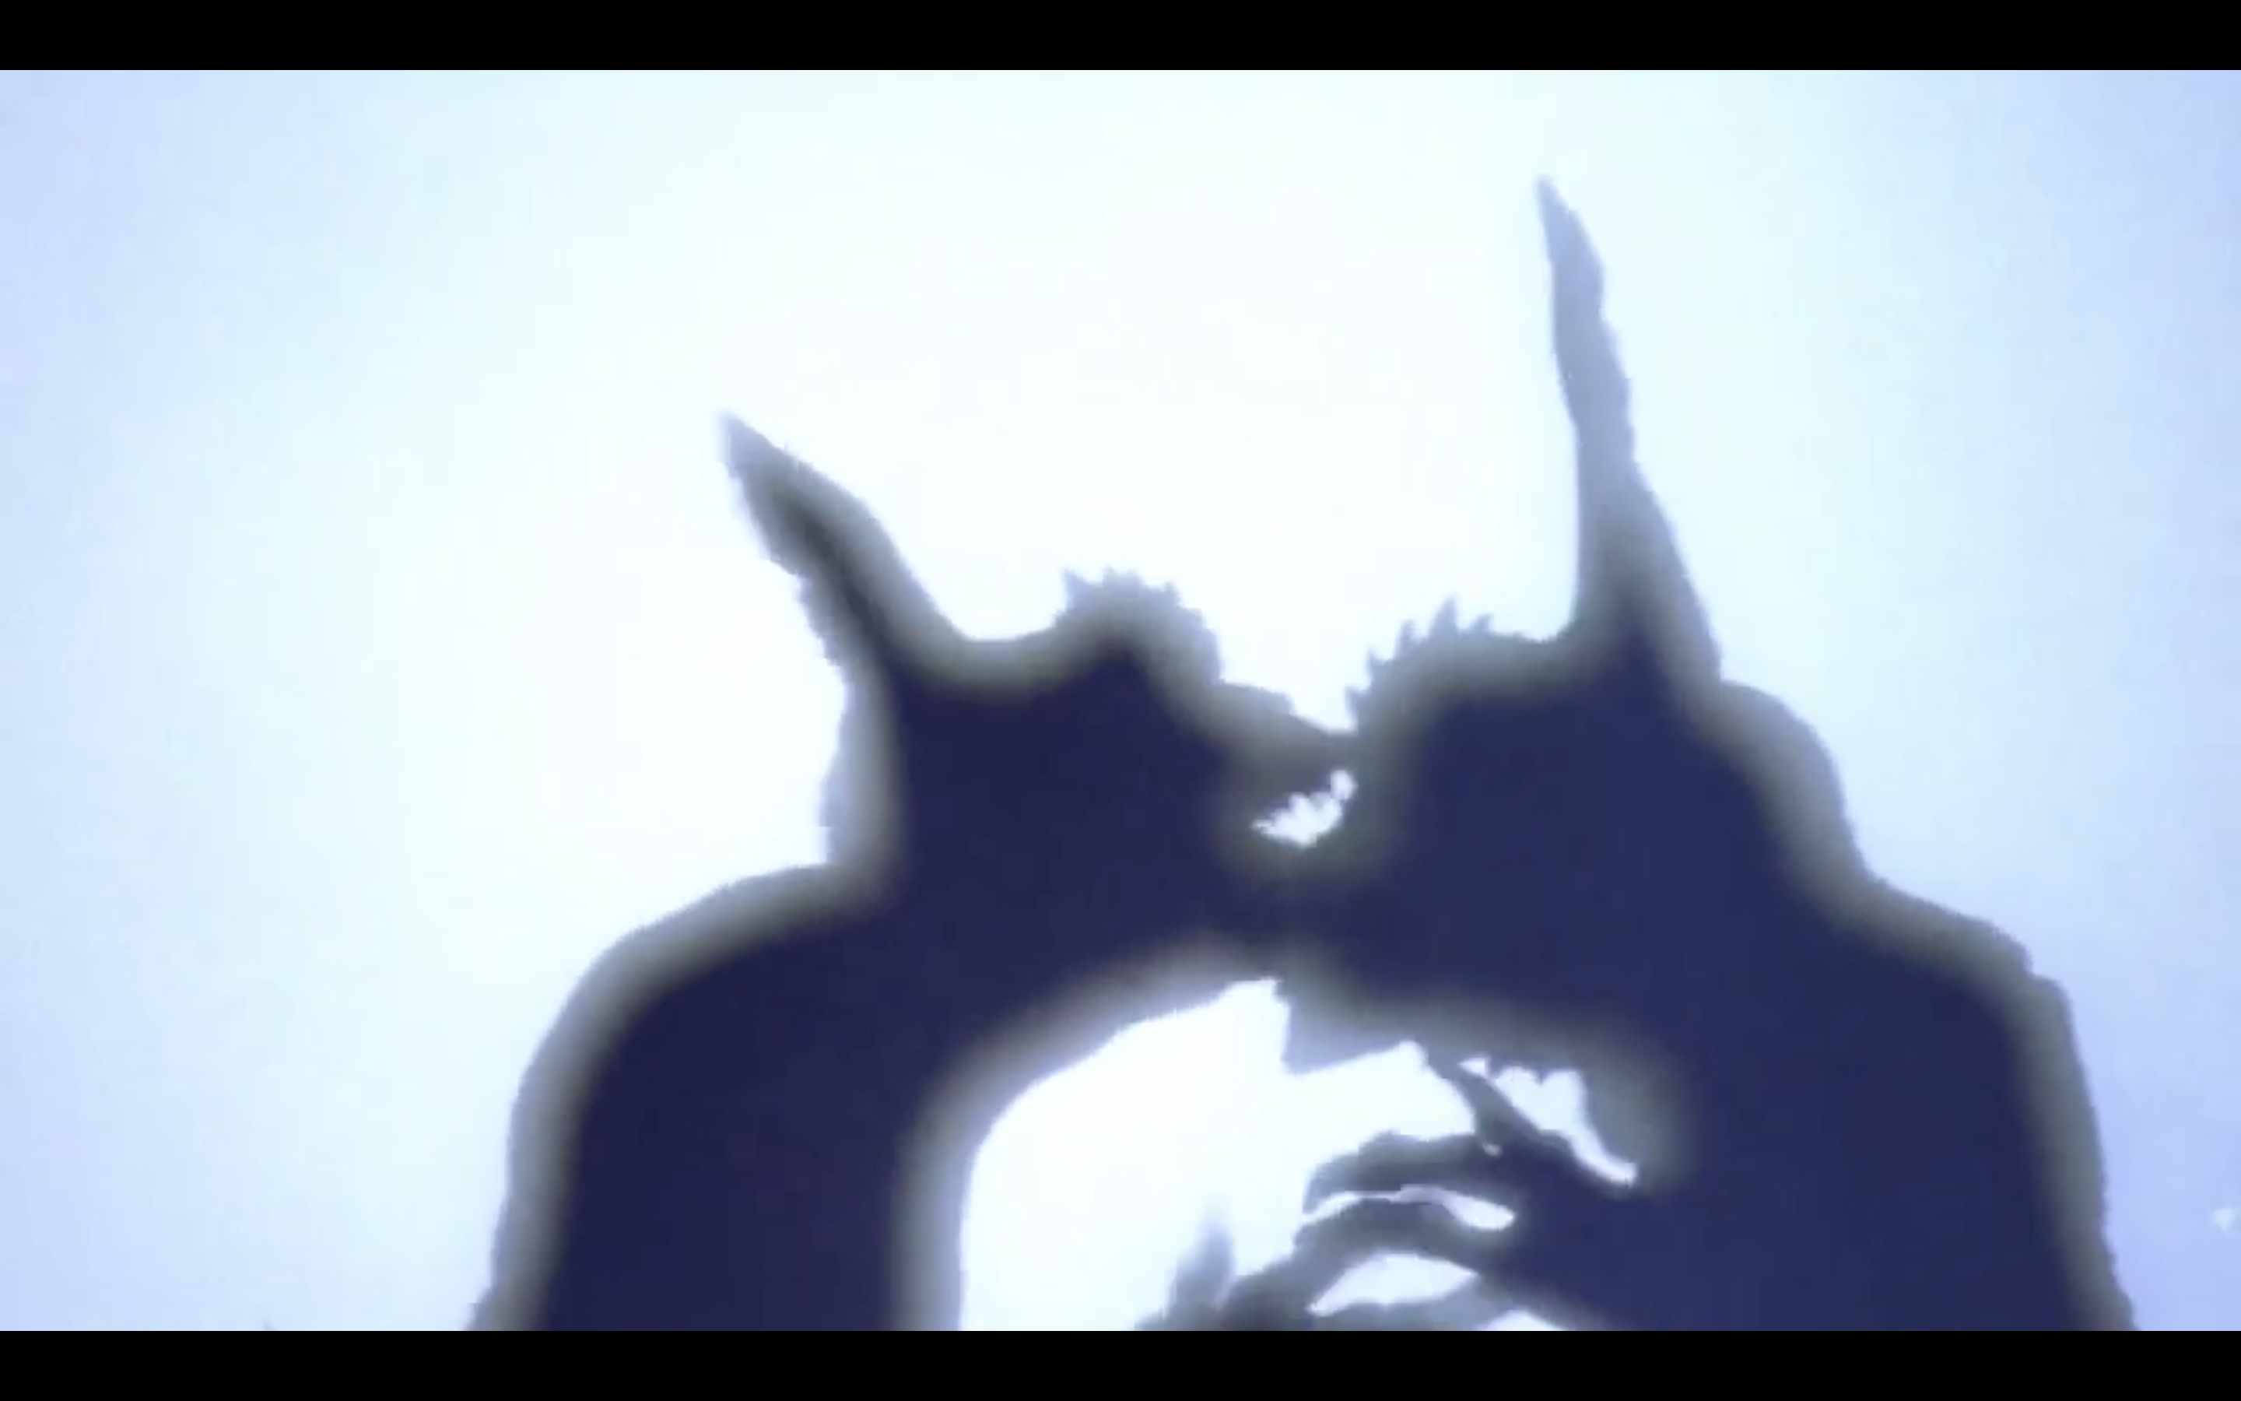
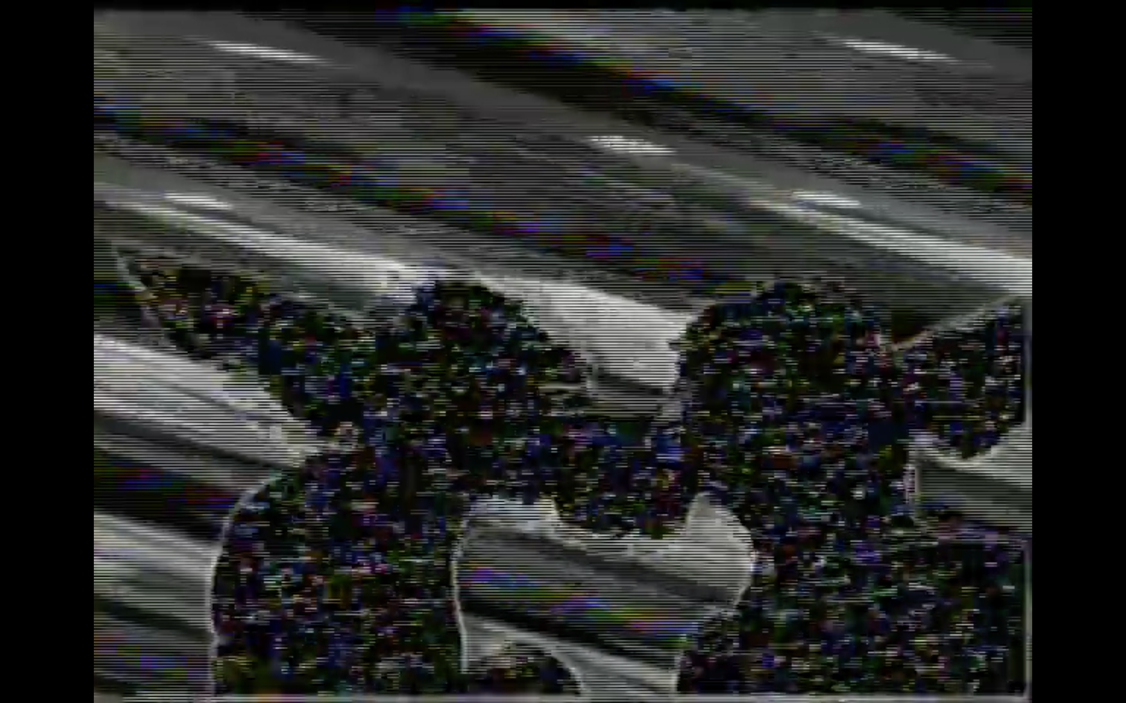
GLITCHES, TECHNOLOGY and GREMLINS
Theatrical version
Home video version

Slide 11
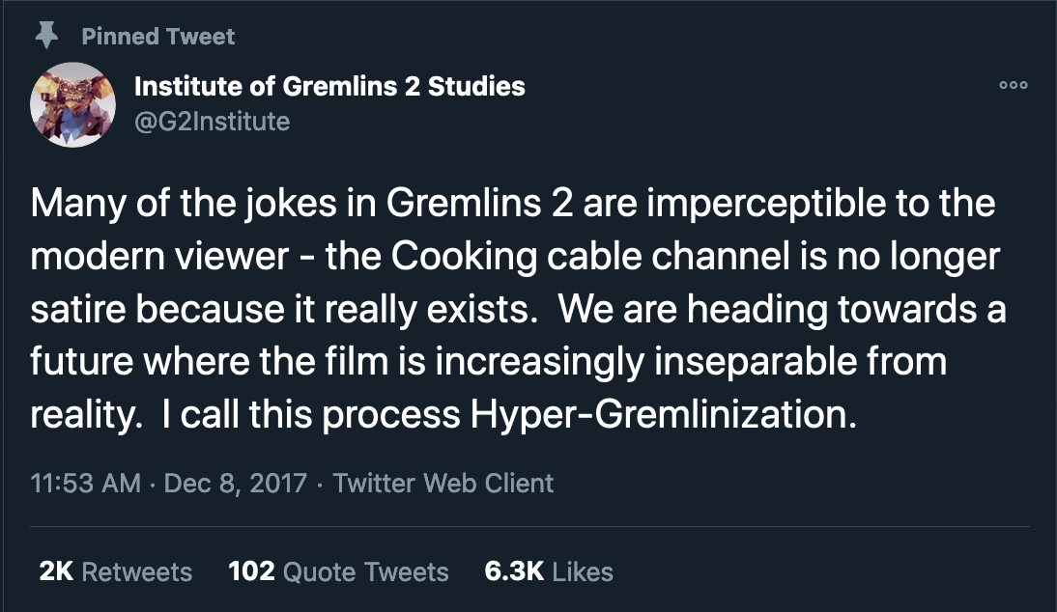
GLITCHES, TECHNOLOGY and GREMLINS

Slide 12
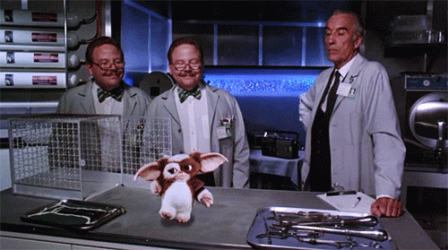
Down the Rabbit Gremlins Hole
Gremlins II Behind the Scenes Videos and Interviews With Joe Dante and Rick Baker
Jeu vidéo Gremlins 2
Gremlins wiki
Gremlins 3 Will Be a Full Reboot Says Director Chris Columbus
Institute of Gremlins 2 Studies
An Oral History of Gremlins 2: The New Batch

